Slide 1

TREDNET
Lab Talk, June 2024

Slide 2
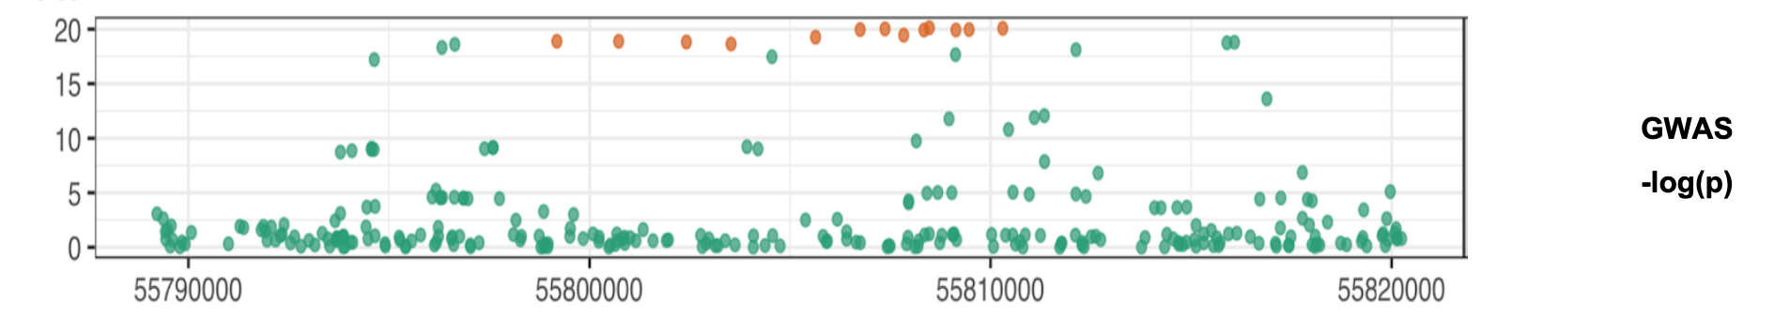
Check the
SNPs in GWAS
Select a disease: Type 2 diabetes
SNPs in GWAS
GWAS
400+ SNPs

Slide 3
GWAS
Check the
SNPs in GWAS
Select a disease: Type 2 diabetes
400+ SNPs
SNPs in GWAS

Slide 4
SNPs in GWAS
GWAS
Check the
LD block with R2>0.7
Select a disease: Type 2 diabetes
?
12000+ SNPs

Slide 5
A deep learning model for enhancer activity prediction

Slide 6
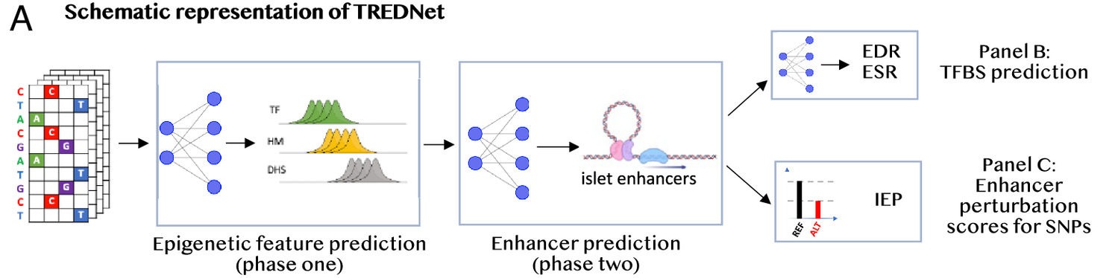
A deep learning model for enhancer activity prediction
Phase 1
Phase 2
Phase 3
Human genome
Regulatory elements
annotations
Cross-tissue enhancer
activity
Enhancer mutational
profiles
Hudaiberdiev, S. et al., 2023

Slide 7
A deep learning model for enhancer activity prediction
Phase 1
Phase 2
Phase 3
Human genome
Regulatory elements
annotations
Cross-tissue enhancer
activity
Enhancer mutational
profiles
Hudaiberdiev, S. et al., 2023

Slide 8


A deep learning model for enhancer activity prediction
Phase 1
Human genome
Regulatory elements
annotations
Phase 2
Phase 3
Roadmap Epigenomics
Cross-tissue enhancer
activity
Enhancer mutational
profiles
Hudaiberdiev, S. et al., 2023

Slide 9
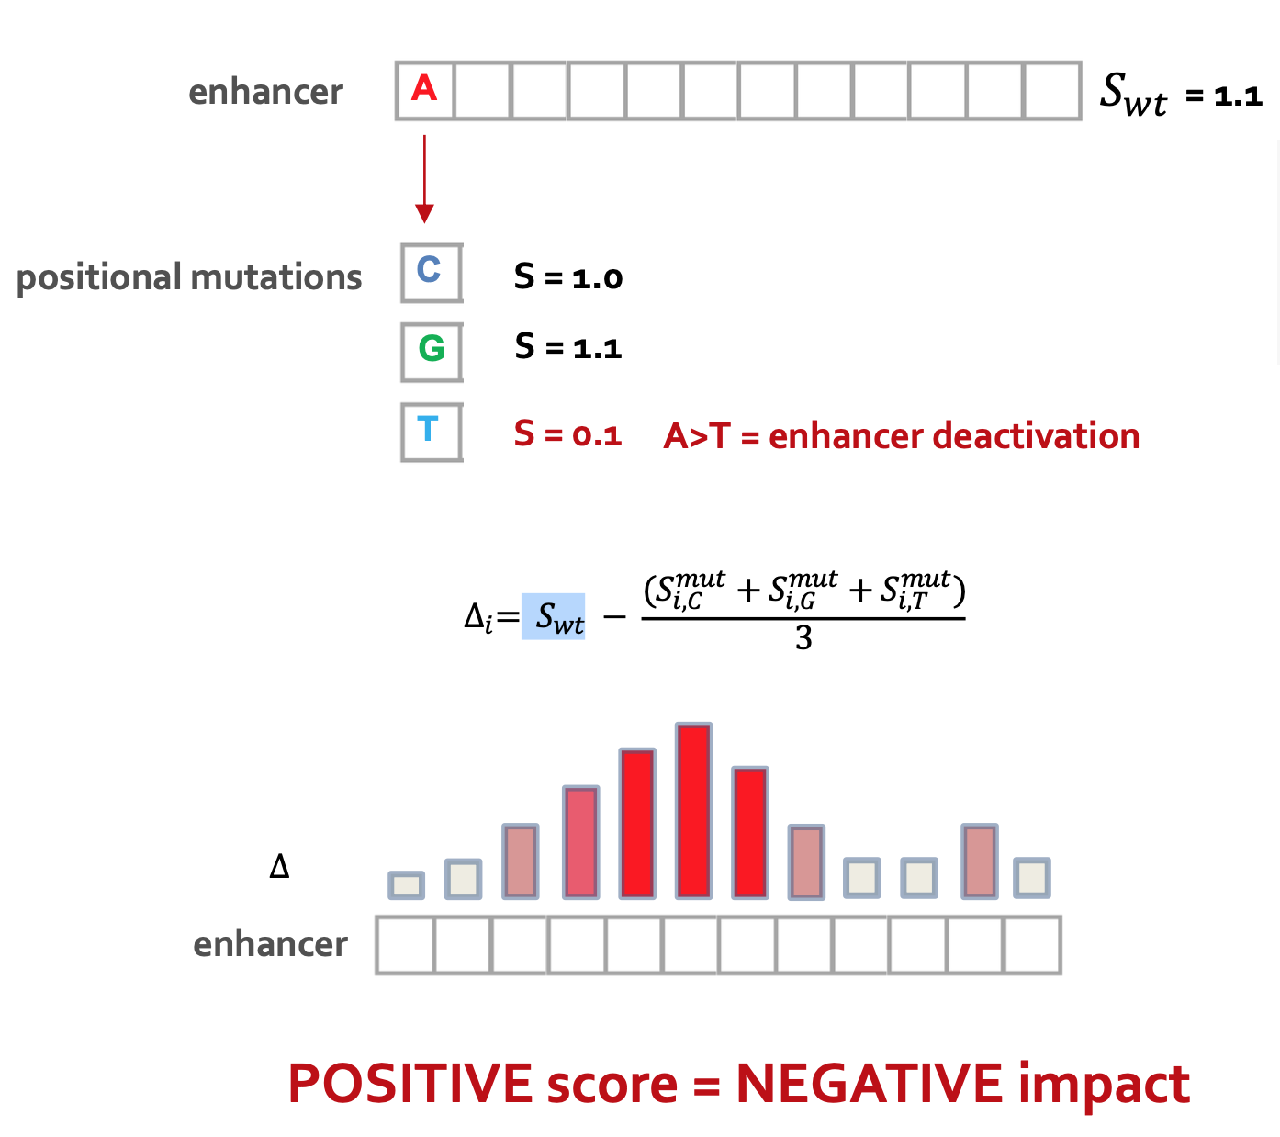
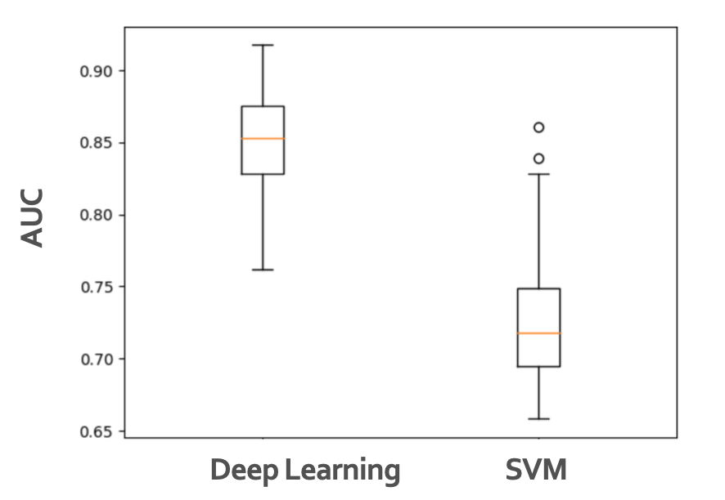
A deep learning model for enhancer activity prediction
Phase 1
Phase 2
Phase 3
Human genome
Regulatory elements
annotations
(tissue/cell line specific)
Cross-tissue enhancer
activity
(2-4k features)
(44 tissues/cell lines)
Roadmap Epigenomics
Enhancer mutational
profiles
Hudaiberdiev, S. et al., 2023

Slide 10
A deep learning model for enhancer activity prediction
Phase 2
Phase 1
Phase 3
Regulatory elements
annotations
Human genome
Cross-tissue enhancer
activity
(tissue/cell line specific)
(2-4k features)
(44 tissues/cell lines)
Roadmap Epigenomics
Enhancer mutational
profiles
Hudaiberdiev, S. et al., 2023

Slide 11
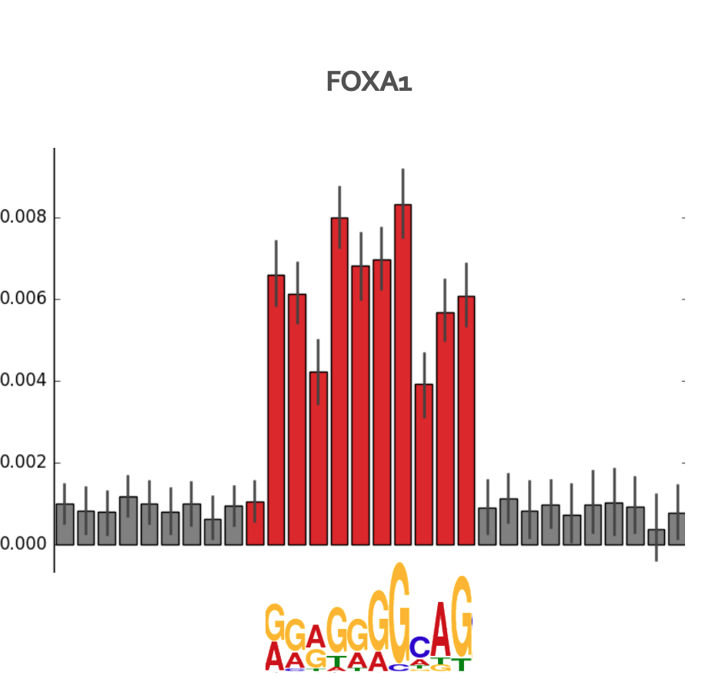
TREDNet predicts strong effects of mutations within motifs of key liver TFs
Phase 2
Phase 1
Phase 3
Regulatory elements
annotations
Human genome
Cross-tissue enhancer
activity
Enhancer mutational
profiles
(tissue/cell line specific)
(2-4k features)
(44 tissues/cell lines)
Roadmap Epigenomics
Hudaiberdiev, S. et al., 2023

Slide 12
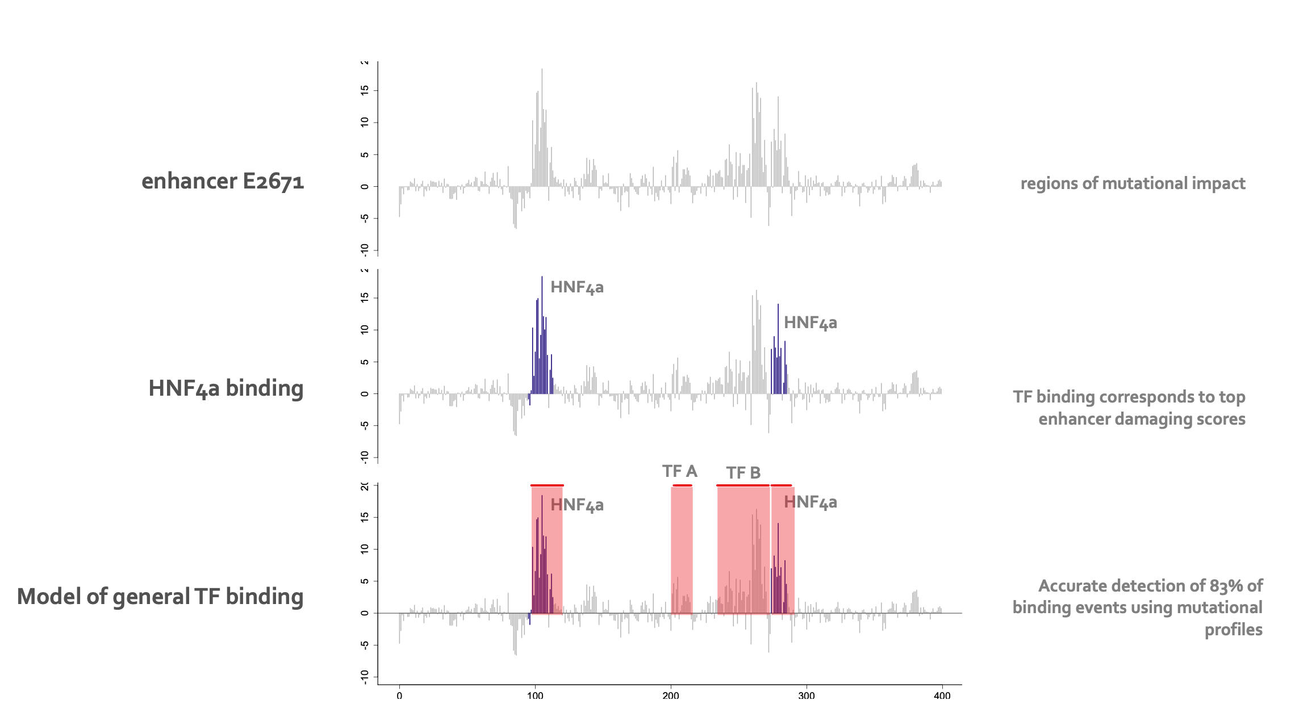
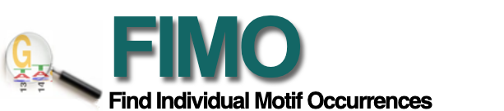
TREDNet predicts strong effects of mutations within motifs of key liver TFs
Causative noncoding variants associated with pancreatic function in Type 2 Diabetes (T2D)
Phase 2
Phase 1
Phase 3
enhancer mutational profiles
Regulatory elements
annotations
Human genome
Cross-tissue enhancer
activity
Enhancer mutational
profiles
(tissue/cell line specific)
(2-4k features)
(44 tissues/cell lines)
Roadmap Epigenomics
Hudaiberdiev, S. et al., 2023

Slide 13
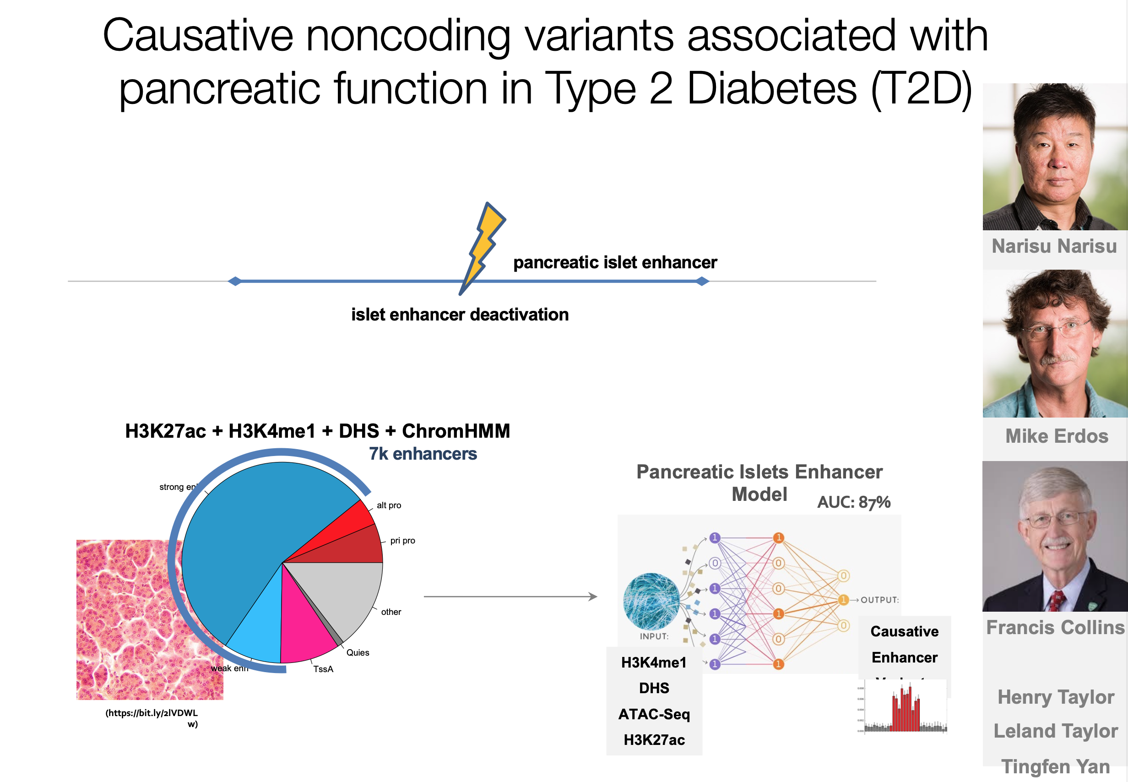
Causative noncoding variants associated with pancreatic function in Type 2 Diabetes (T2D)

Slide 14
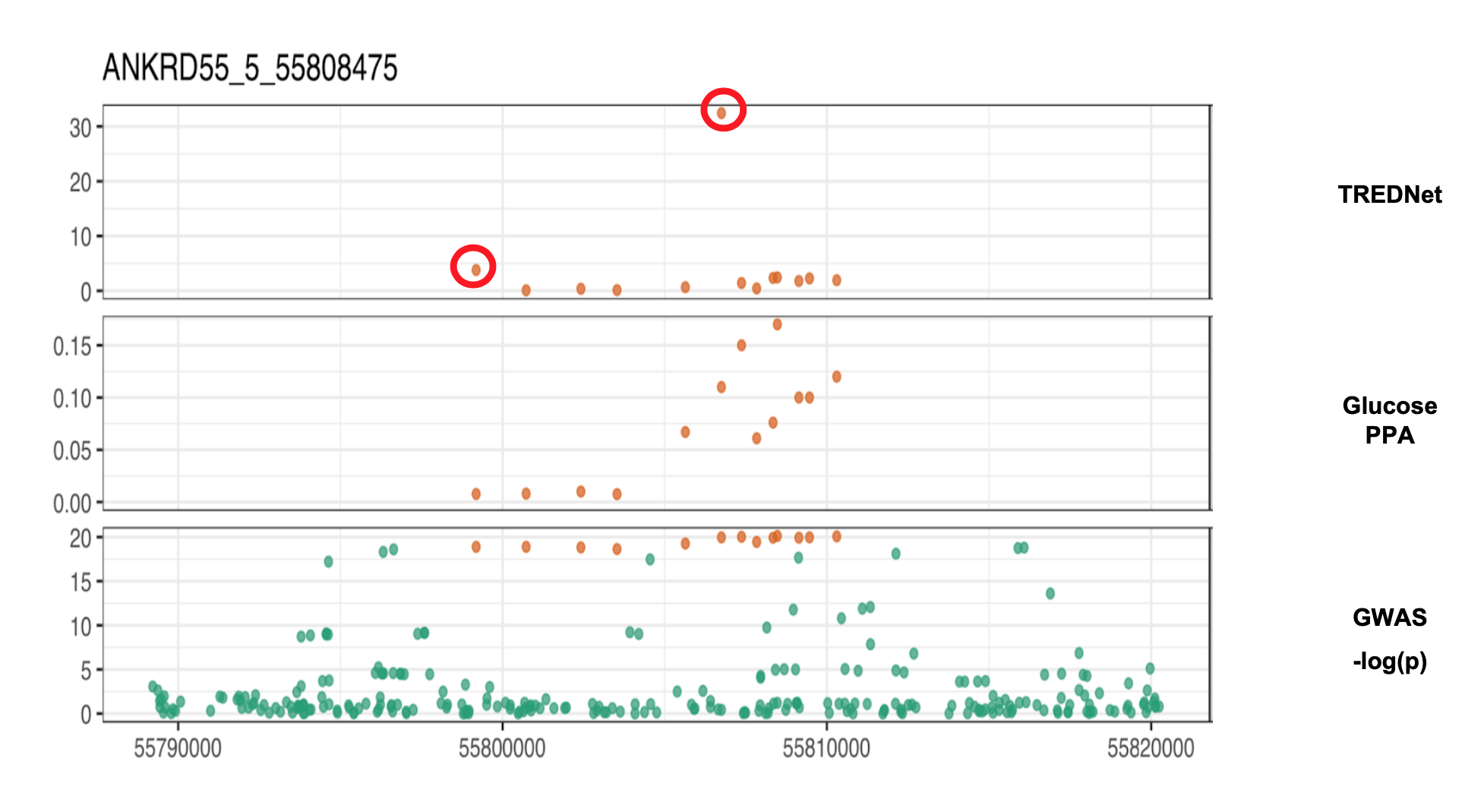
TREDNet resolves T2D GWAS

Slide 15
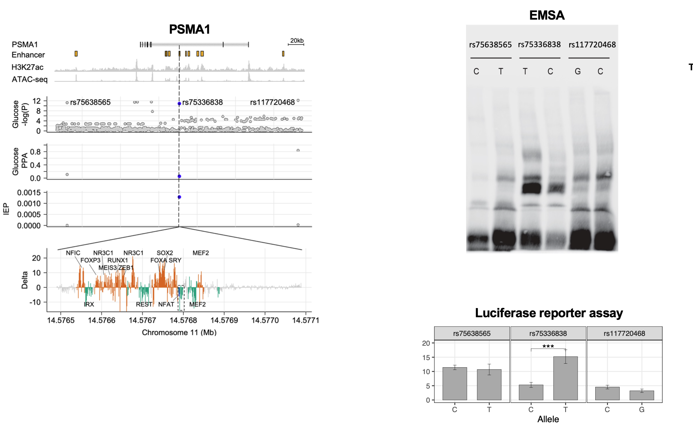
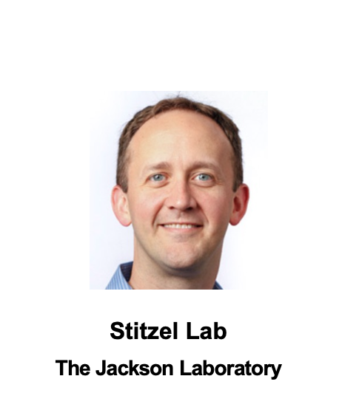
TREDNet predicted causal SNP

Slide 16
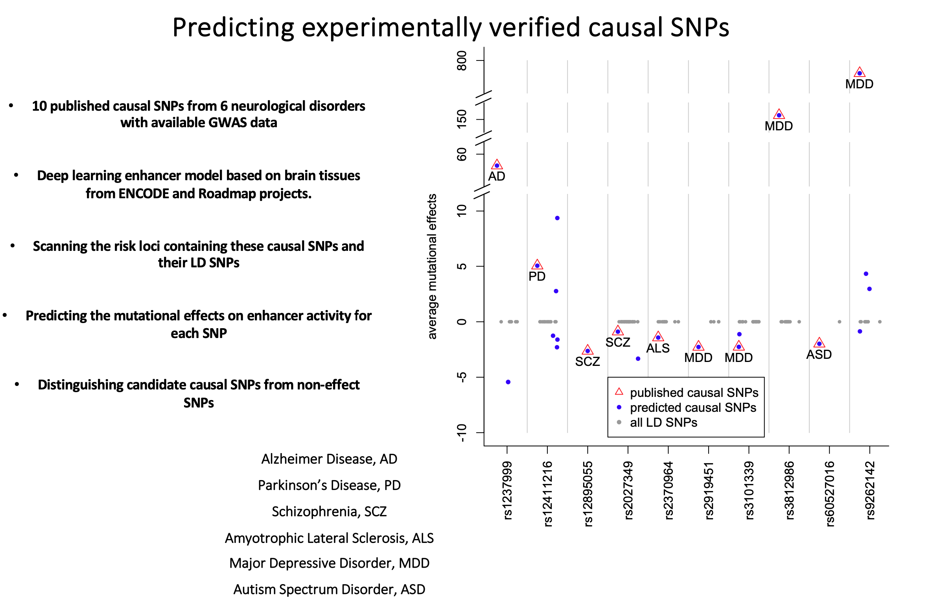
TREDNet predicts causal SNP and beyond

Slide 17
What are the limitations?
Computational Resources
Model Architectures
Bias (e.g., chr 8-9 as test set)
No plug-and-play

